Slide 1

NOIP Basic Algorithms
August 26 , 2018​​
Note: Please turn off your microphone and camera.
Mr. Gao's Algorithm
Competition Training Camp

Slide 2
enumeration
Note: Please turn off your microphone and camera.
Mr. Gao's Algorithm
Competition Training Camp

Slide 3
What is enumeration?
Also known as exhaustive search.
Deterministic results vs. results within a possible range
Enumeration is just an algorithmic approach; solving problems correctly requires solid coding foundation.
Key problems and common techniques
Does the time complexity meet the requirements?
Selection of enumeration objects
Enumeration order

Slide 4
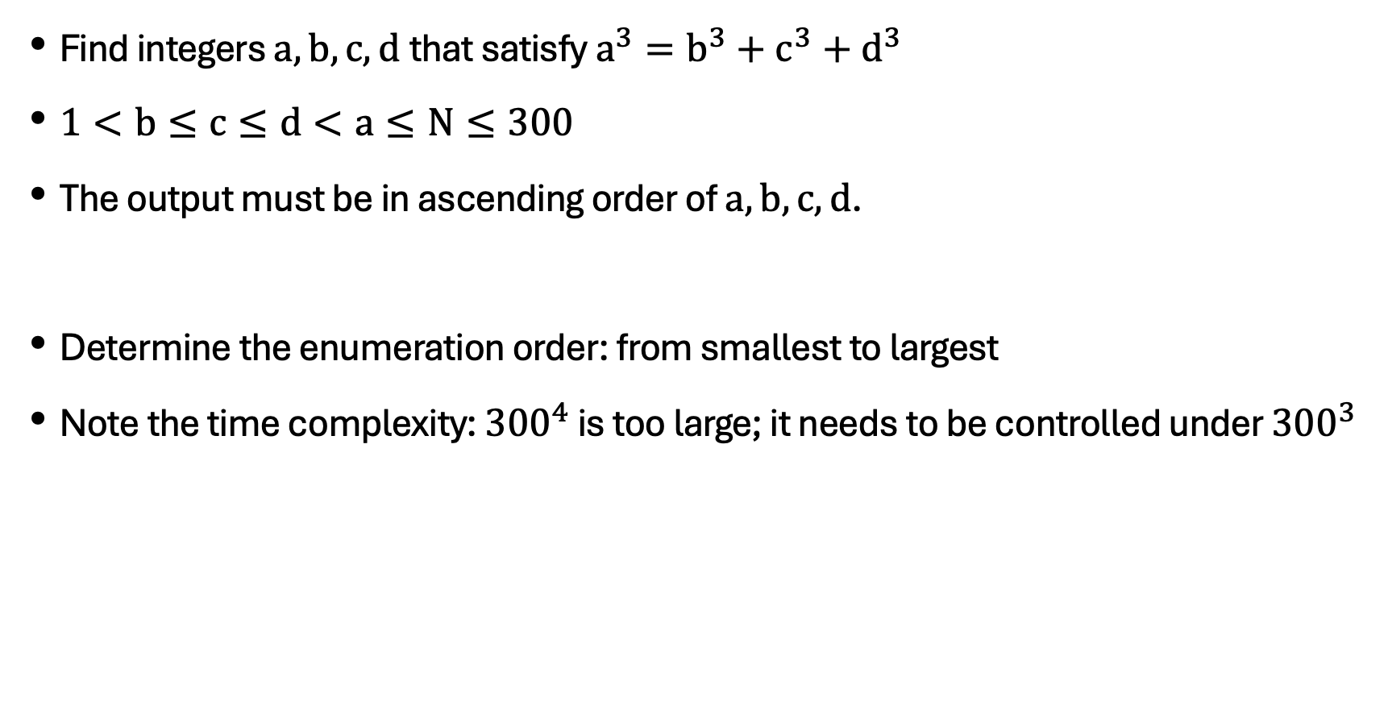
Perfect Cube
Find integers $a,b,c,d$that satisfy $a^{3}=b^{3}+c^{3}+d^{3}$
$1<b≤c≤d<a≤N≤300$
The output must be in ascending order of $a,b,c,d$.
Determine the enumeration order: from smallest to largest
Note the time complexity: ${300}^{4}$ is too large; it needs to be controlled under ${300}^{3}$

Slide 5
Competition Rankings
5 athletes participate in a 100-meter dash. Each athlete has predictions of the outcome. Some other constraints will be provided. The goal is to determine the outcome.
Note: This is not an Olympiad math problem. Do not calculate it in a maths way!
Determine the enumeration object: ranking

Slide 6
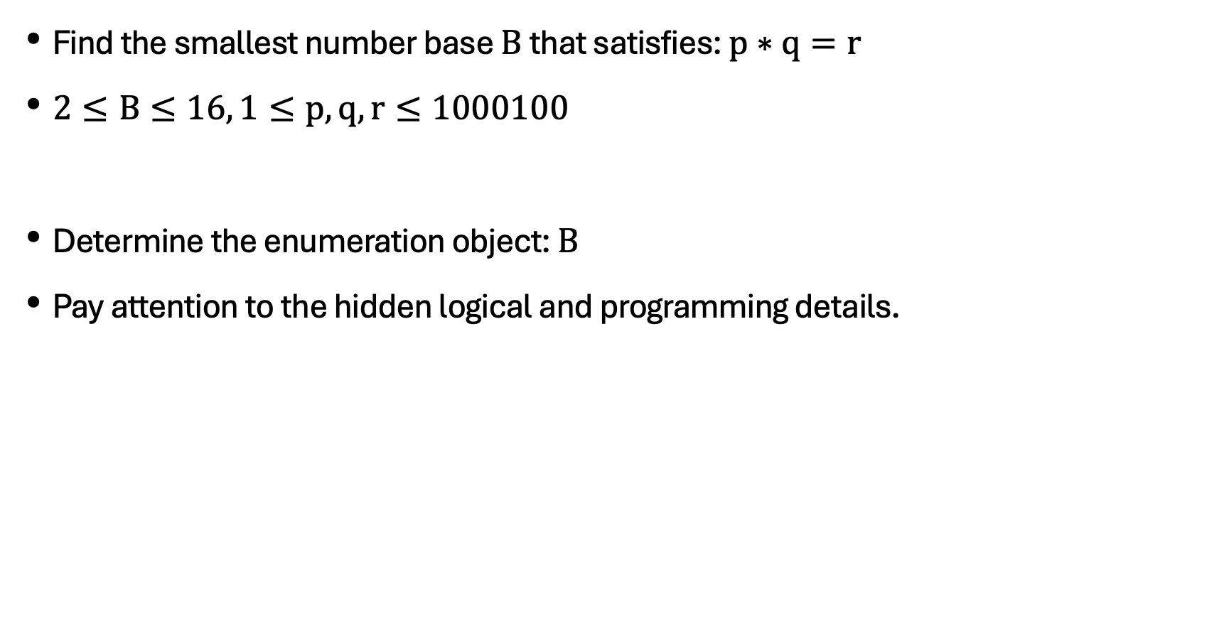
Determine the number base
Find the smallest number base $B$that satisfies: $p∗q=r$
$2≤B≤16, 1≤p,q,r≤1000100$
Determine the enumeration object: $B$
Pay attention to the hidden logical and programming details.

Slide 7
Lights out problem
There is a 5 rows by 6 columns array of lights. Pressing the button will flip the status of 5 lights. Find a way to turn off all the lights.
Determine the enumeration object: Which buttons are on the first row?
Programming Techniques: Binary

Slide 8
Factor problem
Given N, find the smallest a such that both a and M-a are factors of N.
Determine the enumeration object: a
Pay attention to details

Slide 9
Minecraft
Given N , find the cuboid with the smallest surface area.
Define the enumeration objects: length, width, and height.

Slide 10
Biological cycles
Given the cycles of physical, emotional, and intellectual abilities, and the day of the peak of each cycle, find the first day when the three peaks occur on the same day.
Determine the enumeration object: the answer ( a day after d ).

Slide 11
Rubbish bomb
an area of size S*S , N rubbish collection points, and a bomb with an effective blast range of D , find the maximum amount of rubbish that a single bomb can clean up.
Two enumeration schemes:
Enumerate the bomb drop points
Enumerating the contribution of garbage
The algorithm complexity varies greatly.

Slide 12
Thank you everyone.
Note: Please turn off your microphone and camera.
Teacher Gao's Algorithm Competition Training Camp

